Slide 1
Data Structure and Algorithms
(CS212)
Instructor : Dr Syed Musharaf Ali
ROOM G-104-DSE IIUI
Ph# 051-9019724 Ext-2724

Slide 2
Algorithm Complexity Analysis
Efficiency of an algorithm can be analysed at two different stages, before implementation and after implementation.
Priori analysis of algorithms: It means we do analysis (space and time) of an algorithm prior to running it on specific system - that is, we determine time and space complexity of algorithm by just seeing the algorithm rather than running it on particular system
Posteriori analysis of algorithms: It means we do analysis of algorithm only after running it on system. It directly depends on system and changes from system to system.

Slide 3
Algorithm Complexity Analysis
An algorithm is said to be efficient and fast, if it takes less time to execute and consumes less memory space.
The performance of an algorithm is measured on the basis of following properties :
Time Complexity: Time Complexity is a way to represent the amount of time needed by the program to run to the completion.
Space Complexity: Amount of memory space required by the algorithm

Slide 4
Space Complexity
Space complexity of an algorithm represents the amount of memory space required by the algorithm in its life cycle. The space required by an algorithm is equal to the sum of the following two components
A fixed part that is a memory space required to store certain data and variables, that are independent of the input size of the problem. For example, simple variables and constants used, program size, etc.
A variable part is a memory space required by variables, whose size depends on the input size of the problem. For example, dynamic memory allocation, stack space, etc.

Slide 5
Space Complexity
Space complexity S(P) of any algorithm P:
S(P) = C(n) + S(n)
where C is the fixed part and S is the variable part of the algorithm, which depends on the input size n.

Slide 6
Space Complexity
Example1 −
Algorithm: SUM(A, B)
Step 1 - START
Step 2 - C ← A + B + 10
Step 3 - Stop
Here we have three variables A, B, and C and one constant. Hence
S(P) = 1(n) + 3(n)
Now, space depends on data types of given variables and constant types and it will be multiplied accordingly.
N represents number of bytes variable holds.

Slide 7
Space Complexity
Constant Space Complexity
int square(int a)
{
return a*a;
}
it requires 4 bytes of memory to store variable 'a' and another 4 bytes of memory is used for return value.
Totally it requires 8 bytes of memory to complete its execution.
If the amount of space required by an algorithm constant, then that space complexity is said to be Constant Space Complexity

Slide 8
Space Complexity
Linear Space Complexity
int sum(int A[ ], int n)
{
int sum = 0;
for(int i = 0; i < n; i++)
sum = sum + A[i];
return sum;
}
If the amount of space required by an algorithm is increased with the increase of input value, then that space complexity is said to be Linear Space Complexity

Slide 9
Time Complexity
Time complexity of an algorithm represents the amount of time required by the algorithm to run to the completion.
Constant Time Complexity
Statement;
We have a single statement. Its Time Complexity will be Constant.
Notes:
a function is a relation between a set of inputs and a set of permissible outputs

Slide 10
Time Complexity
Linear Time Complexity
For ( int i=0; i<n; i++)
{
Statement;
}
The time complexity for the above algorithm will be Linear. The running time of the loop is directly proportional to n. When n doubles, so does the running time.
Notes:
a function is a relation between a set of inputs and a set of permissible outputs

Slide 11
Time Complexity
Quadratic Time Complexity
For ( int i=0; i<n; i++)
{
For ( int j=0; j<n; j++)
{
Statement;
}
}
The time complexity for the above code will be Quadratic. The running time of the two loops is proportional to the square of n. When n doubles, the running time increases by n * n.
Notes:
a function is a relation between a set of inputs and a set of permissible outputs

Slide 12
Algorithm Analysis: Example
Analyze algorithm after design
Example
50 packages delivered to 50 different houses
50 houses one mile apart, in the same area
FIGURE 1-1 Gift shop and each dot representing a house

Slide 13
Example (cont’d.)
Driver picks up all 50 packages
Drives one mile to first house, delivers first package
Drives another mile, delivers second package
Drives another mile, delivers third package, and so on
Distance driven to deliver packages
1+1+1+… +1 = 50 miles
Total distance traveled: 50 + 50 = 100 miles
FIGURE 1-2 Package delivering scheme

Slide 14

Example (cont’d.)
Similar route to deliver another set of 50 packages
Driver picks up first package, drives one mile to the first house, delivers package, returns to the shop
Driver picks up second package, drives two miles, delivers second package, returns to the shop
Total distance traveled
2 * (1+2+3+…+50) = 2550 miles
FIGURE 1-3 Another package delivery scheme

Slide 15
Example (cont’d.)
n packages to deliver to n houses, each one mile apart
First scheme: total distance traveled
1+1+1+… +n = 2n miles
Function of n ---- f(N)
Second scheme: total distance traveled
2 * (1+2+3+…+n) = 2*(n(n+1) / 2) = n²+n miles
Function of n² ---- f(N²)

Slide 16
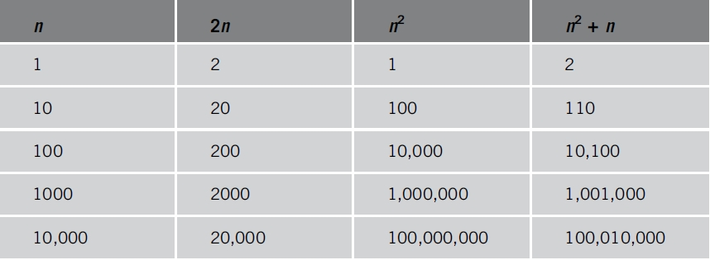
Algorithm Analysis:
Analyzing an algorithm
Count number of operations performed
Not affected by computer speed
TABLE 1-1 Various values of n, 2n, n², and n² + n

Slide 17
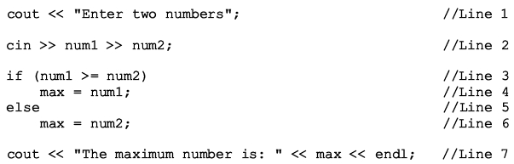
Algorithm Analysis:
Example 1-1
Illustrates fixed number of executed operations
Total number of operations = 8

Slide 18
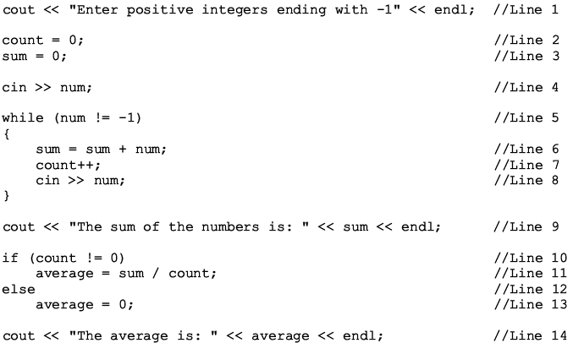
Algorithm Analysis
Example 1-2
Illustrates dominant operations
Total number of operations = 5n + 15 or 5n + 14

